Slide 1

BASIC OF CIVIL ENGINEERING (TCE 101)
UNIT- 1 (SYLLABUS)
Introduction and Scope of Civil Engineering:
Introduction: History of Civil Engineering in India. Civil Engineering Marvels in India and abroad.
Various Civil Engineering branches and their scope.
Role of Civil Engineers in the development of the Nation.
Impact of Infrastructural Development on the economy of our Country.

Slide 2
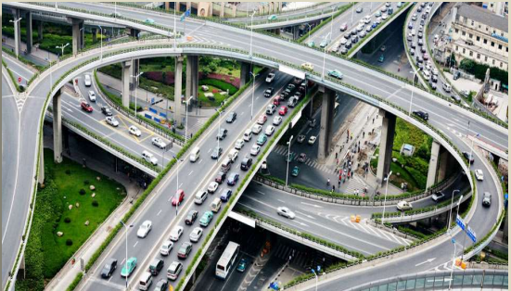
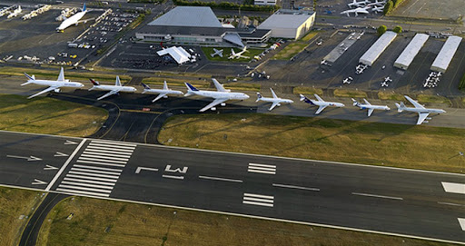
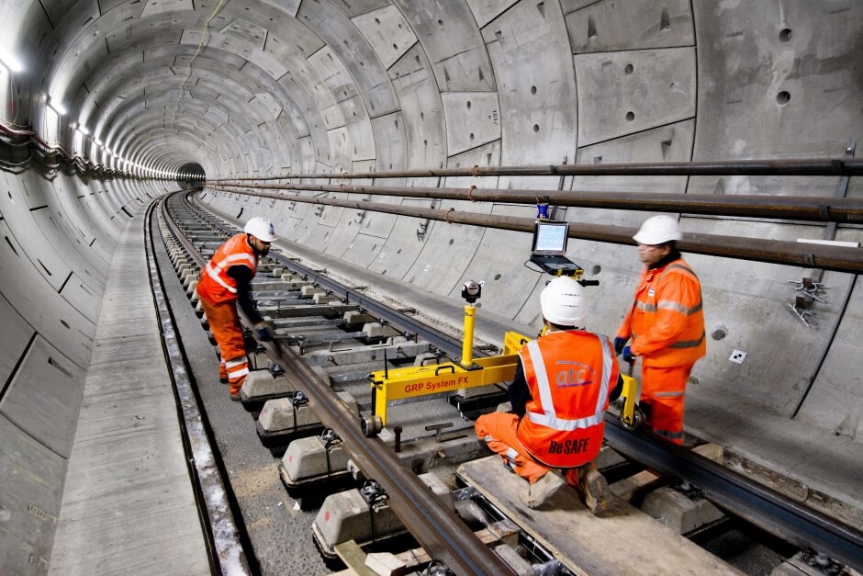
Branches of civil engineering
TRANSPORTATION ENGINEERING

Slide 3
Branches of civil engineering
TRANSPORTATION ENGINEERING
Transportation means movement of passengers and goods by means of vehicles on land, ship on water and aircrafts in air.
Transportation Engineering is that branch of Civil engineering which deals with planning, designing and construction of roads, bridges, railways, tunnels, harbours, ports, docks, runways, and airports.
As for development of any nation good transportation network is of prime importance. Study of various construction materials used in construction of roads, traffic engineering are also considered under transportation Engineering.

Slide 4
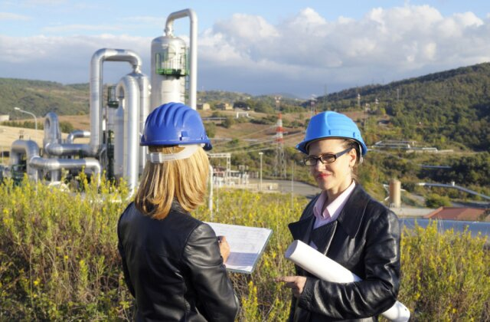
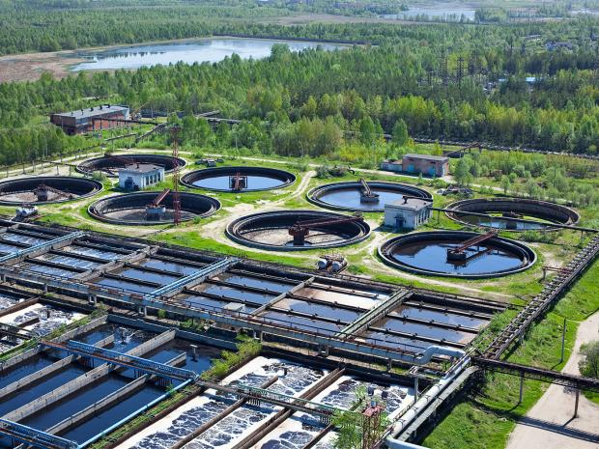


Branches of civil engineering
ENVIRONMENTAL ENGINEERING

Slide 5
Branches of civil engineering
ENVIRONMENTAL ENGINEERING
Environmental Engineering deals with pollution control and public health engineering.
Different types of pollutions are water, air, noise and other pollution.
Due to large scale industrialization, population growth, rapid urbanization and several other human activities like construction, mining, transportation, environment gets polluted.
Environmental engineering deals with technologies & facilities which are engaged in reducing pollution.
Environmental engineering includes design, construction and maintenance of water treatment plant, waste water treatment plant, water distribution network and sewerage system, it also deals with solid waste management in towns and cities.
Public health engineering includes water treatment, water distribution network, & solid waste management.

Slide 6
Role of Civil Engineers in the development of the Nation
If infrastructure forms the backbone of any nation, then Civil Engineers can be truly termed as Nation Builders.
Building roads, making new flyovers, constructing dams are some of important tasks undertaken by Civil Engineers which can be linked directly to progress of any nation at global arena.
With the changing times and new technologies being introduced in the field of construction, the role of Civil Engineers has evolved a lot.
Today’s Civil Engineers are not only confined to supervisor’s role but also lays blueprint by using the modern technology & techniques to make impossible project a reality.
Delhi Metro is best example of extreme engineering and is considered to be one of the finest marvels constructed by Civil Engineers of India. Who would have imagined that a Mass Public Transportation System could be constructed in the unplanned locations of Delhi, where even it is difficult to take a car from one location to another? But with the use of technology and hard thinking of Civil Engineers, Delhi Metro is running successfully and the project has truly turned out to be Pride of India.

Slide 7
Infrastructure for Nation Development
Civil engineers play a major role in the infrastructures development of a country. All structures constructed in the past exhibit the path of civilization and current infrastructures development express the practices followed by civil engineers.
Infrastructure can be defined as activities that provide society with services necessary to conduct daily life and to engage in productive activity and development in a country’s economy.
ECONOMY ↔ INFRASTRUCTURE

Slide 8
Infrastructure for Nation Development
Energy
Transport
Irrigation
Finance
Communications
Education
Health
ECONOMY ↔ INFRASTRUCTURE
The knowledge of basic areas of civil engineering can be of great use in providing the infrastructural facilities where constructional aspects are involved for development of regions.

Slide 9
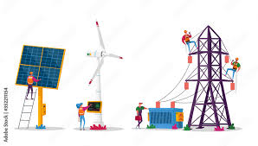
Infrastructure for Nation Development
Energy
Transport
Irrigation
Finance
Communications
Education
Health
Electrical energy is so-far best for transmission of power. Even chemical energy of coal/petrol/ diesel is converted into electrical for long distance transmission .
The construction of dams (for hydro-electric power), wind turbines (for wind energy), nuclear reactors (for nuclear energy), solar power plants, Thermal power plants (for coal/diesel based) requires Civil Engineering
ECONOMY ↔ INFRASTRUCTURE
Also the power produced from all these sources are to be transmitted and distributed to the user through transmission line towers and distribution poles

Slide 10

Infrastructure for Nation Development
Energy
Transport
Irrigation
Finance
Communications
Education
Health
Transportation is a specialization in Civil Engineering
  Roadways
  Railways
  Inland navigation
  Marine transportation
  Airways
ECONOMY ↔ INFRASTRUCTURE

Slide 11
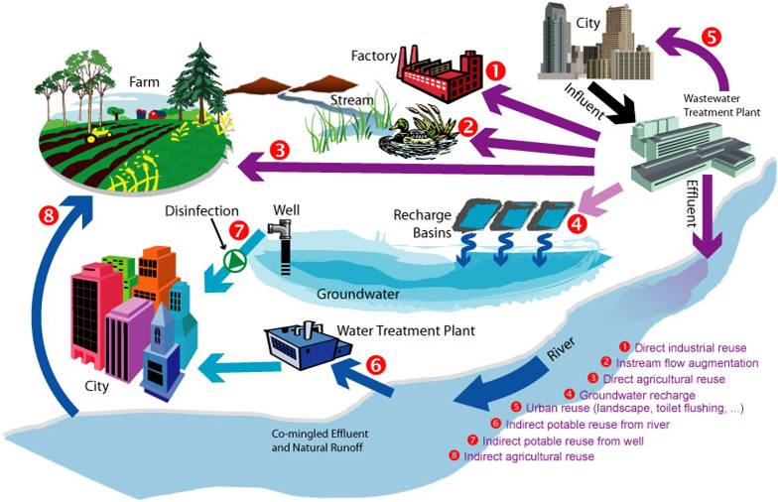
Infrastructure for Nation Development
ECONOMY ↔ INFRASTRUCTURE
Irrigation of agricultural fields and health of human society require supply of water and drainage system
  Construction of dams/ reservoirs
  Canals for distributing the water
  Cross-drainage works
  Water treatment plants
  Pipe network for Water supply
  Sewage disposal and treatment
  Maintenance of River banks for flood control
Energy
Transport
Irrigation
Finance
Communications
Education
Health

Slide 12
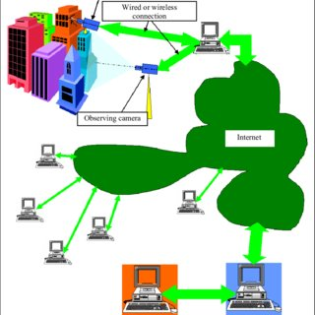
Infrastructure for Nation Development
ECONOMY ↔ INFRASTRUCTURE
Energy
Transport
Irrigation
Finance
Communications
Education
Health
Communication systems and Civil Engineering
  Wired communication
    Fiber optic network
  Wireless Communication
    (microwave towers)
    Satellite launching stations

Slide 13
Infrastructure for Nation Development
Good surface communication links such as tar or concrete rods.
Provision of water supply distribution system i.e. construction of water storage reservation or sumps, laying of underground pipes etc.
Provision of a drainage system which may include construction of surface drains as subsurface drains for the disposal of wastewater.
Supply of electrical power for which construction of transmission line towers, construction of electrical substations.
Providing inland communications lines, i.e telephone lines etc.
Construction of recreational places e.g gardens, parks etc.
ECONOMY ↔ INFRASTRUCTURE

Slide 14
Types and classification of Structures
Buildings
Towers
Chimneys
Bridges
Dams
Retaining Walls
Water Tanks
Silos, Stakes
Cable/Rope Ways
Tunnels
Roads
Railways
Runways
Offshore Structures
Naval Structures
Pipelines
Inland Waterways.

Slide 15
Thank you

